Slide 1
QuarcksTACK OVERVIEW

Slide 2
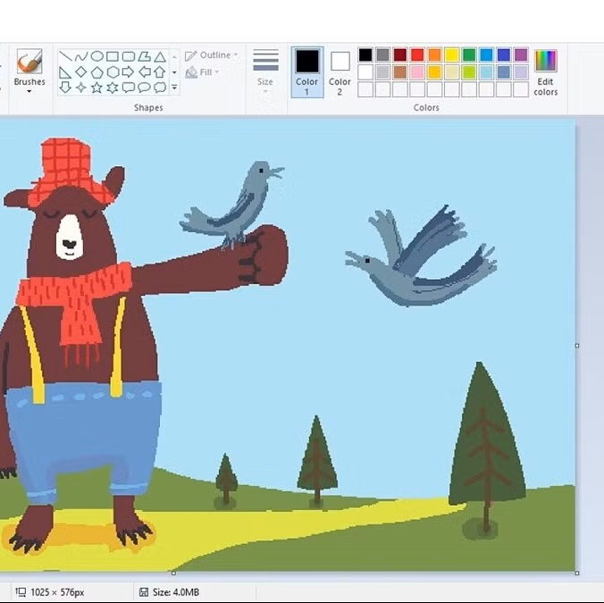
WHY ARE WE HERE
The idea of what we have, we want to create a competition and creativity for our players and also assist the use of AI to make and determine of drawings .

Slide 3

Elevator pitch
QuarkSketch is a challenging social drawing game using AI technology
Players draw, guess, and compete in real-time while facing creative challenges
The AI will determine of its drawings
Players will vote for which drawing is most accurate which determines the number of votes

Slide 4

IN scope/not list
In Scope
In development for Android applications
Responsive and readable UI
Core-app features (drawing features, game settings)
Frequent testing and bug fixing
Out of Scope
Post-launch new features development
Marketing
PC Client application standalone

Slide 5
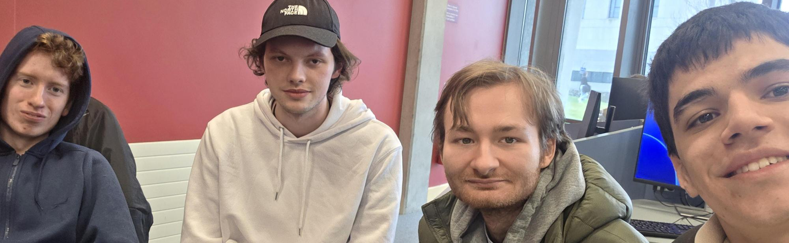
Meet the neighbours
Marko Radojcic – QA Tester
Niall Concannon – Project Owner
Daniel Balcerzak – Scrum Master
Kamil Ciemniejewski – Dev Ops

Slide 6
Architecture overview
Players configure difficulty and player count
AI randomly selects a drawing topic based on difficulty
Drawing Phase - All players draw their interpretation
Submission Check - System waits for all players to finish
Display Drawings - All submissions shown to players
Voting Phase - Players vote for the best drawing and allocate vote points
Calculate Results - System tallies votes
Display Winner - Leaderboard and winner announcement

Slide 7
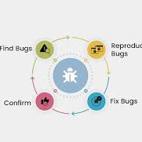
What keeps us up at night?
Some of the risks that can occur are:
Adding too many features and running out of time
Bugs or performance issues with the drawing canvas
Difficulty balancing team workload
Underestimate how long features will take to implement

Slide 8
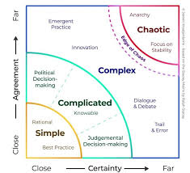
Size it up
We can’t say exactly how long it’s going to take to do this project. However:
Estimated project duration is around 8 weeks
Core functionality developed first
Features built in small Scrum sprints
Improvements and testing will be done throughout development

Slide 9

Whats going to give
Extra drawing tolls will be removed if needed
User accounts or score history may be dropped
UI design may be simplified
Main focus will remain on canvas, prompts and timer

Slide 10
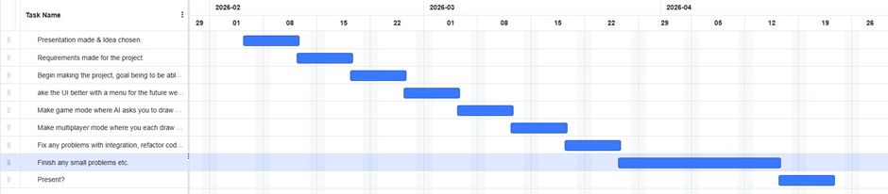

Slide 11
Whats it going to take?
Time
12/02: Idea chosen
19/02: Requirements ready
26/02–05/03: Core drawing + UI
12/03–19/03: AI game + multiplayer
26/03–16/04: Integration & testing
23/04: Present
Cost
Minimal (student project; dev time + free/open-source tools)
Resources
4 people: frontend, backend, AI, UI/UX & testing

